Slide 1
Disclosure:
The speaker of this presentation is the founder of Via Scientific Inc., and has a financial interest in the company's success. Additionally, Via Scientific has a partnership with UMass Chan Medical School, where the speaker is currently employed as an associate professor. These potential conflicts of interest will be disclosed throughout the presentation to ensure transparency and objectivity.

Slide 2


Alper Kucukural, PhD Sep 4, 2024

Slide 3

Presentation Agenda
Via Scientific – Background
Challenges
Via Foundry Overview
Key Values
Linux tutorial
Summary / Forward Thinking
1
2
3
4
5
6

Slide 4
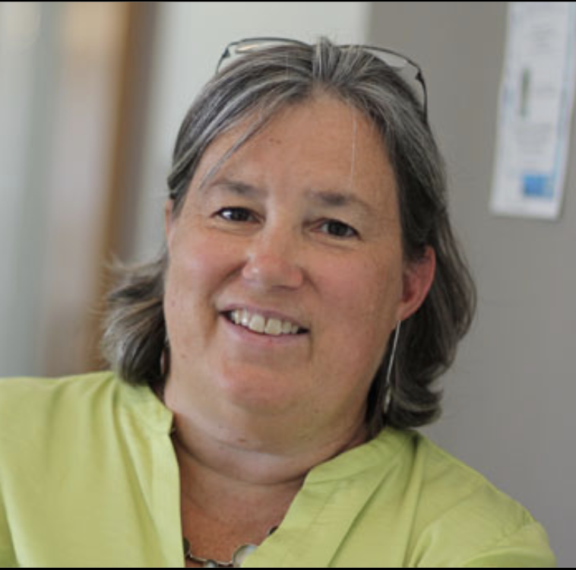



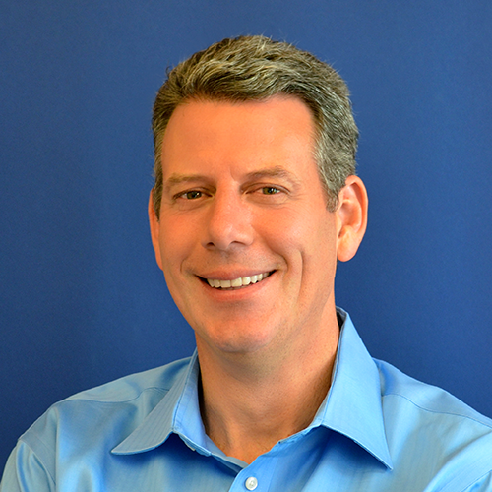
Background
Founders
Born of science
UMass Chan
Deep domain expertise
Shaped by thousands of interactions
Rapidly expanding
Power of community
History
Melissa J. Moore, PhD
Founder, Moderna, UMass Chan Medical
Alper Kucukural, PhD
Founder, CTO, UMass Chan Medical
Global scale multi-omics and data analytics radically simplified & intelligently amplified.
Generate novel insights and biological breakthroughs
that change the world.
Manuel Garber, PhD
Founder, UMass Chan Medical
Mission
Jim Crowley
Founder, CEO, Forge.AI
Via Scientific, Inc. | Proprietary & Confidential

Slide 5
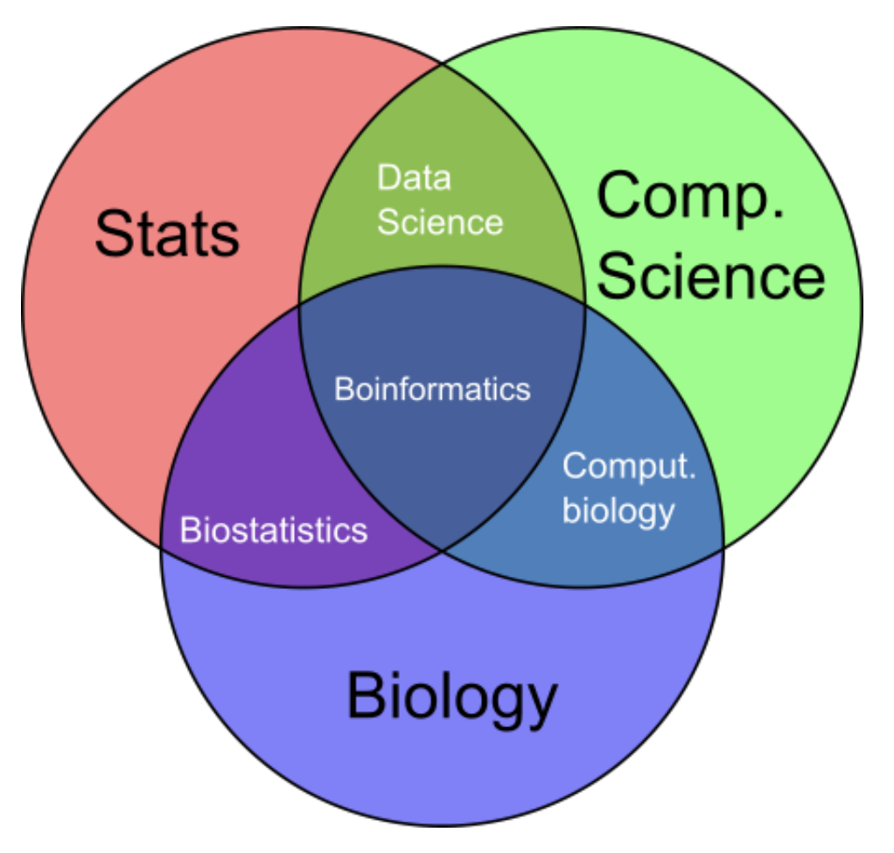

Via Foundry empowers researchers by simplifying omics data processing, analysis with an intuitive web-based operating system that accelerates discoveries and supports collaboration in bioinformatics.
For all skill levels and areas to perform bioinformatics analysis

Slide 6
Sequencing Analysis: A Simplified View
Sample Collection
Sequencing
Data Processing
Analysis
Notes:
Integration with Ontology servers (e.g. National Center for Biomedical Ontology)
Ontology-based m

Slide 7
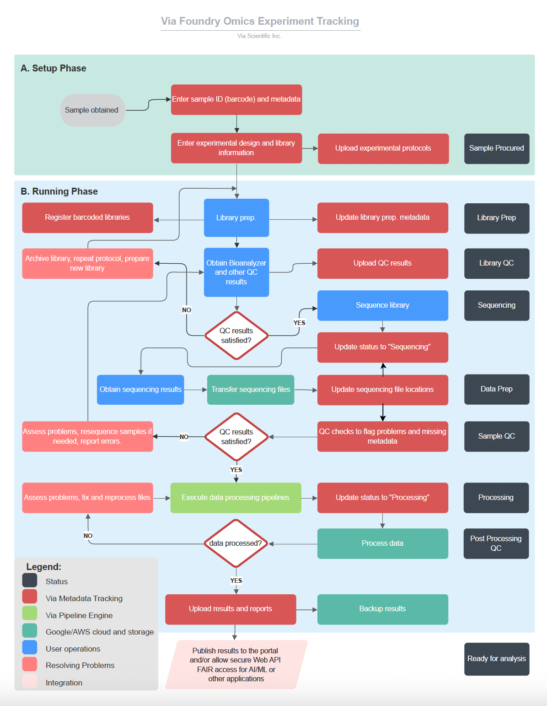
Challenges in study tracking from
beginning to the end

Slide 8
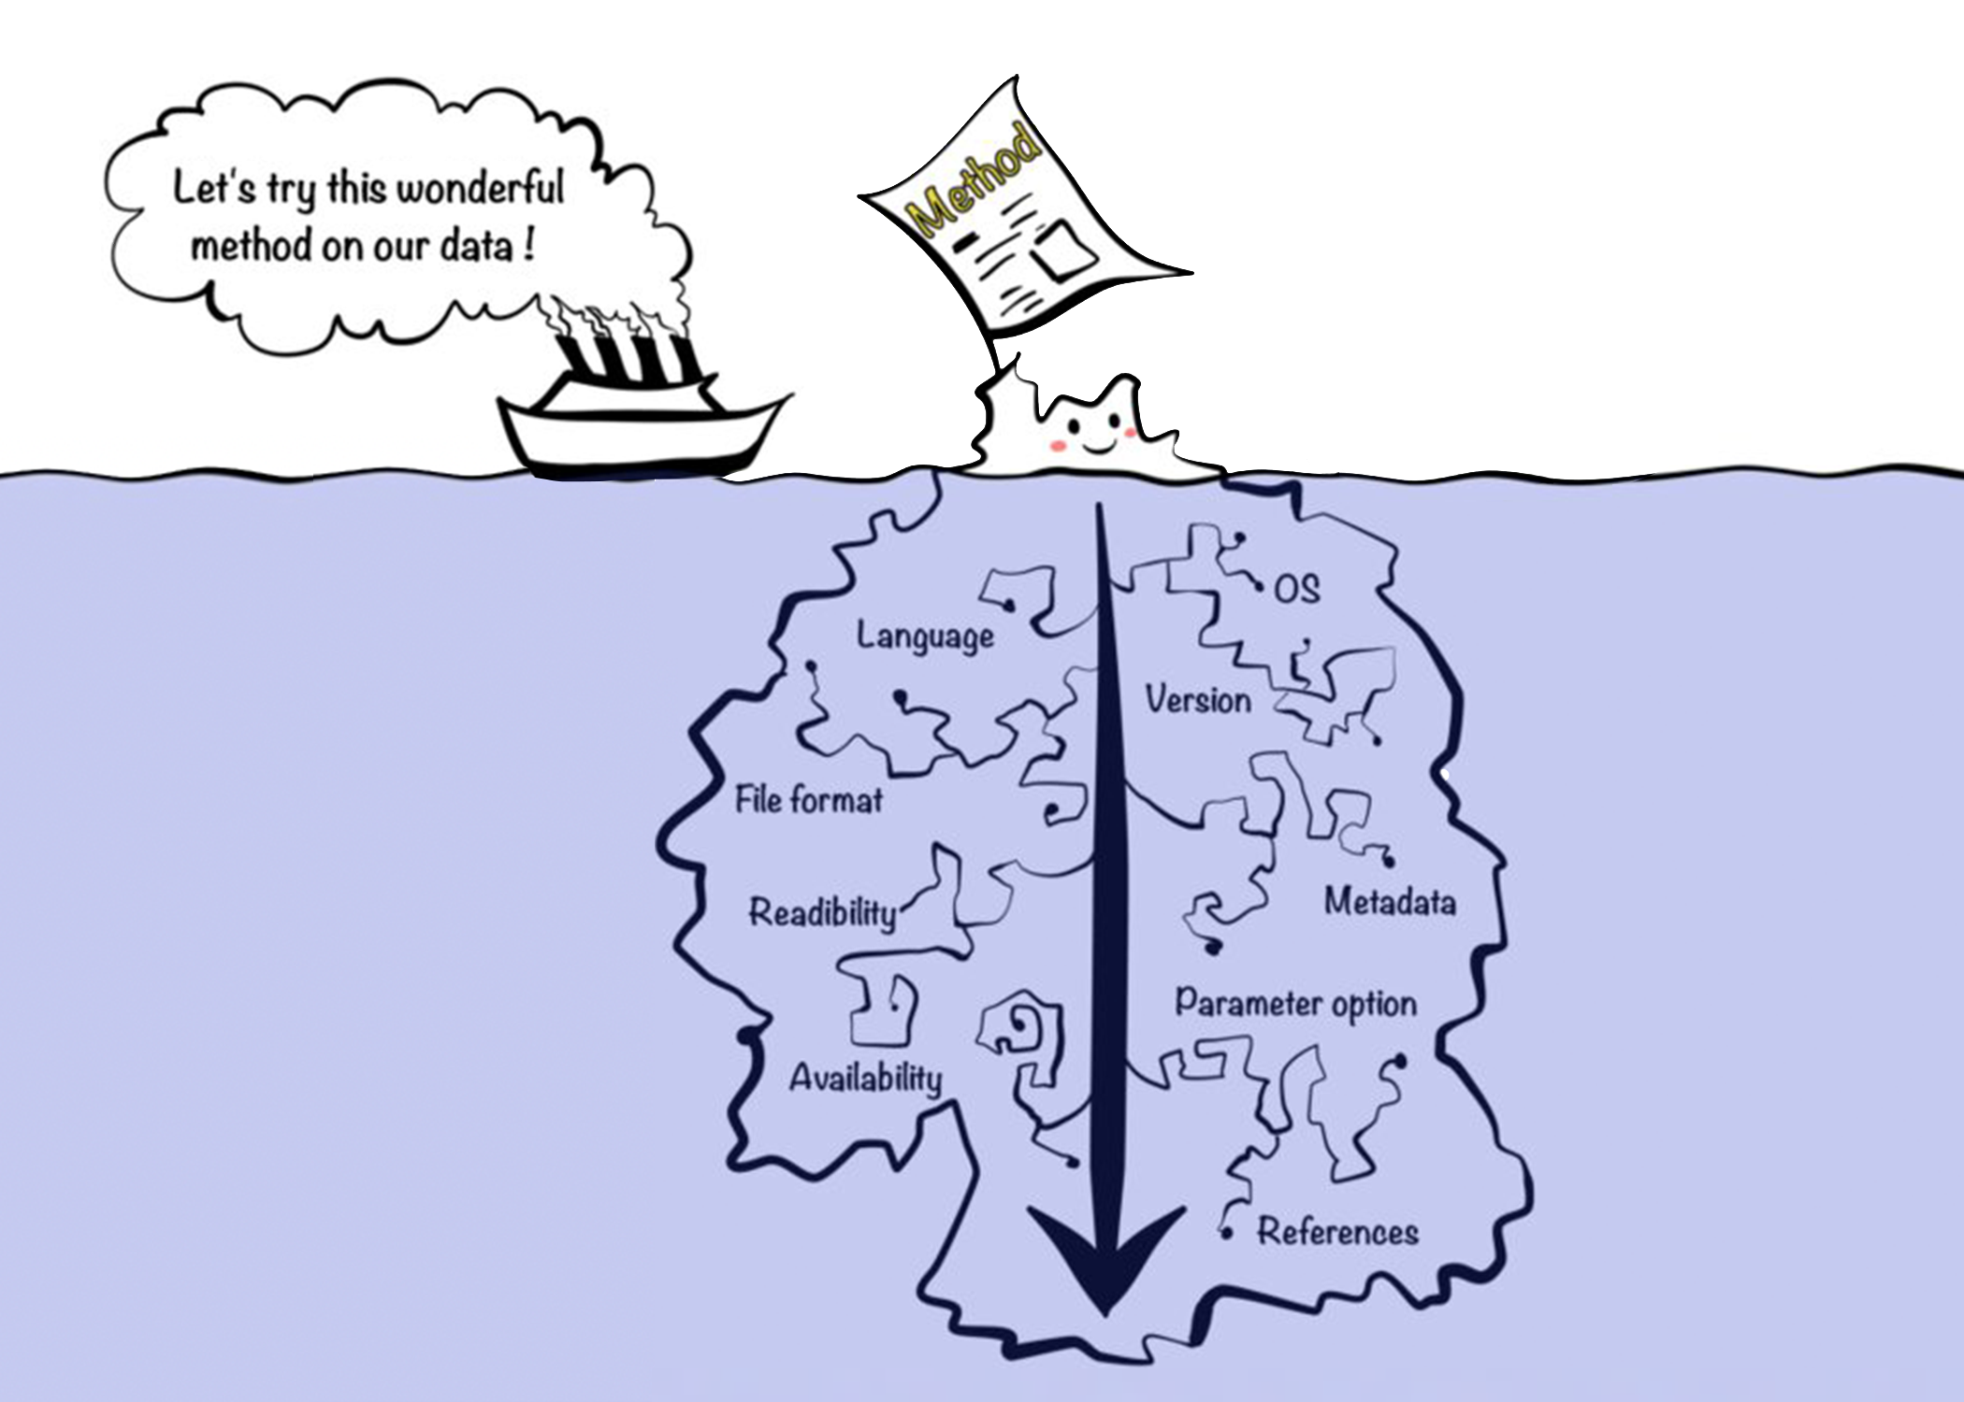
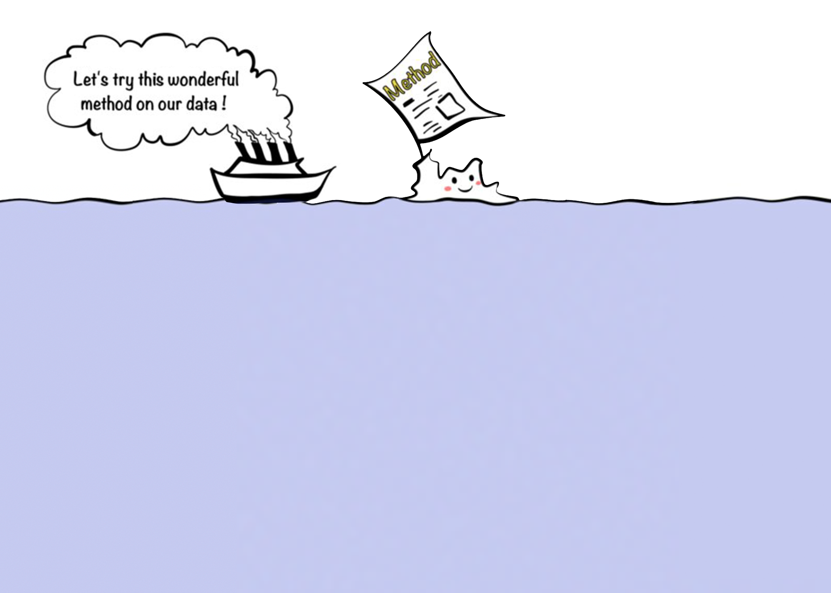
Kim et. al, Jul 2018, Giga Science
Notes:
To be able to use that published method, usually lots of open source software deployed to github, tested by community and travis support. Some of them even include docker or singularity containerization support to run it anywhere. The data can be processed by nextflow or other pipeline systems and can be analyzed by RStudio and Jupyter.

Slide 9
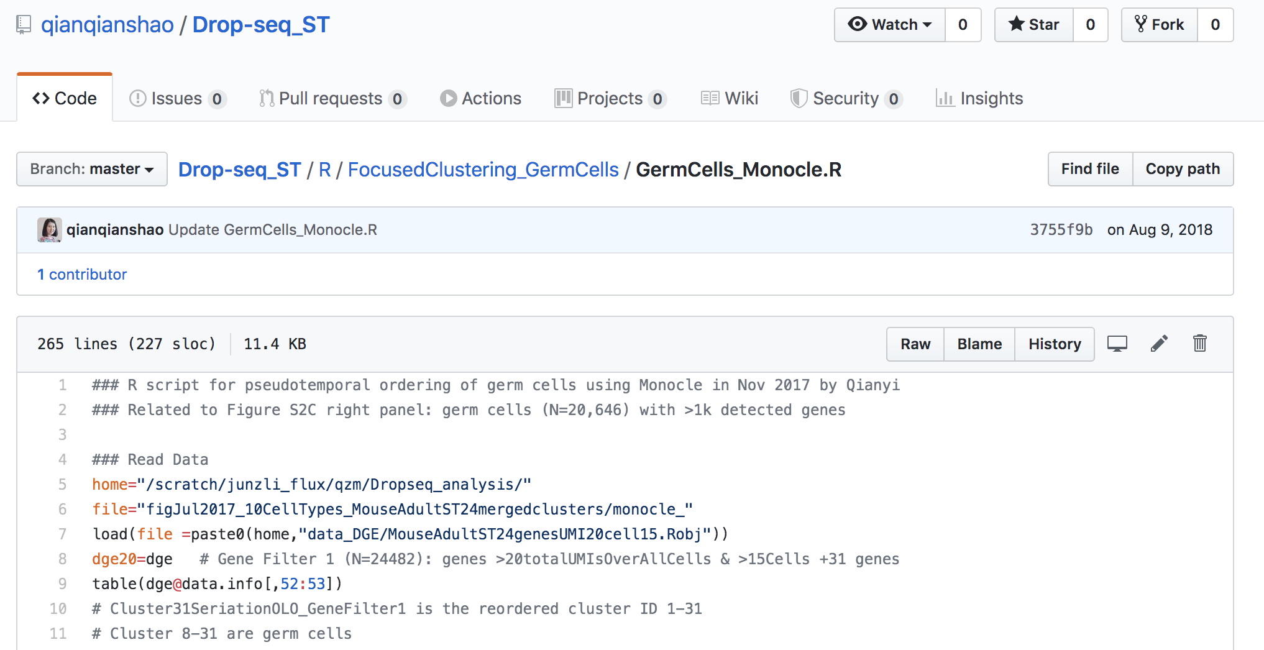
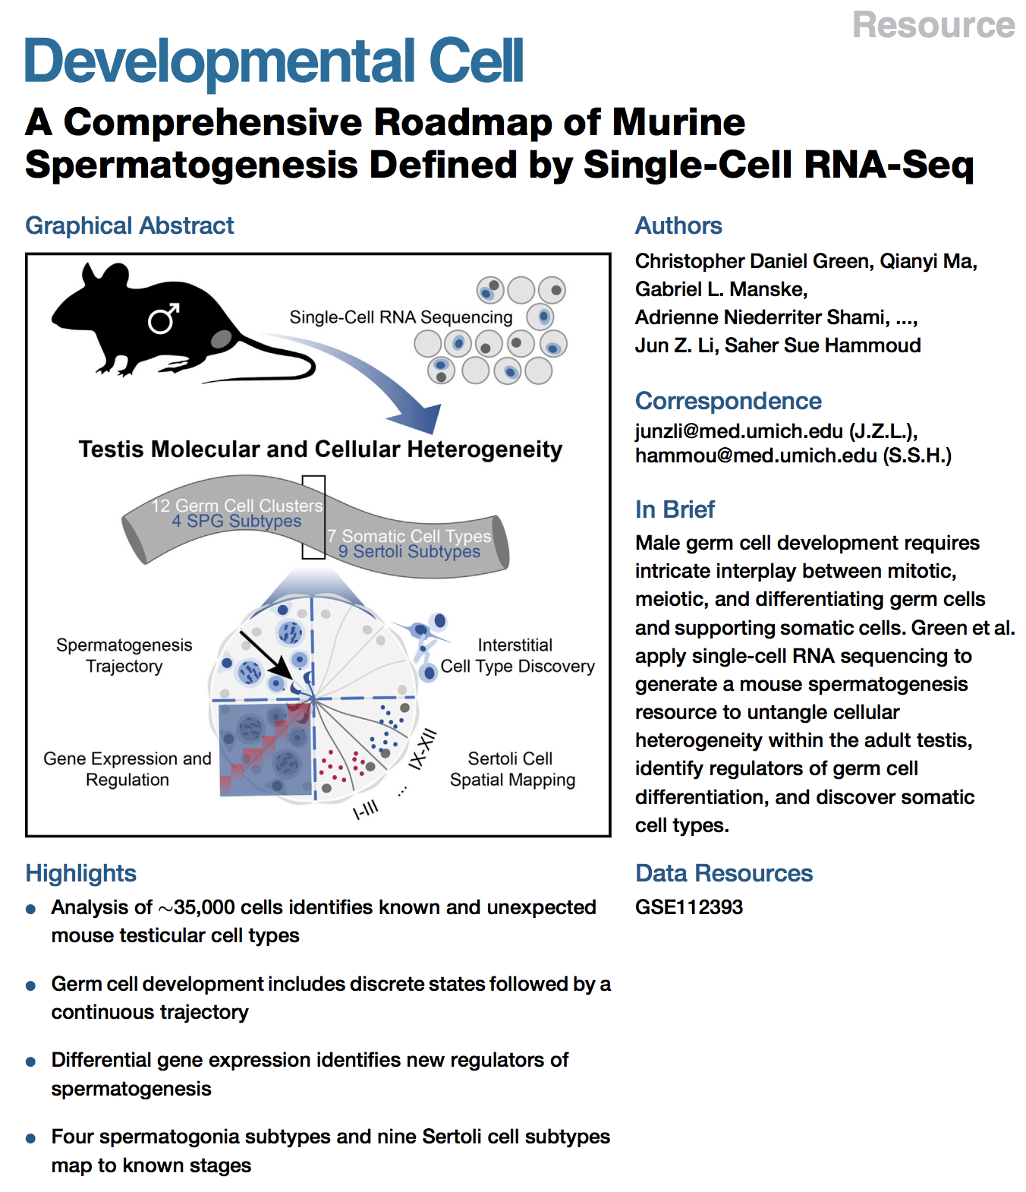
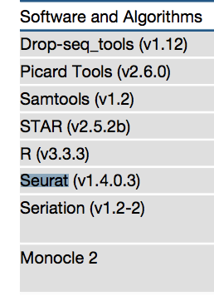
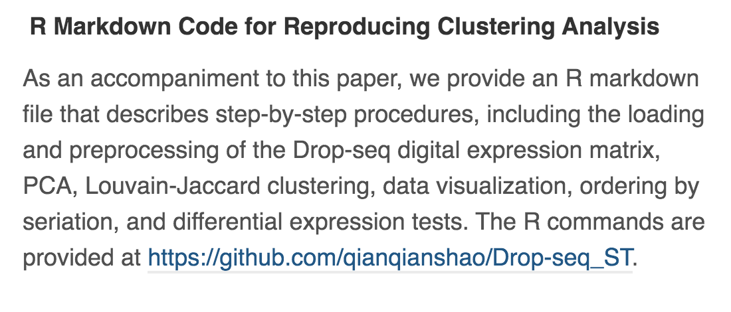

Interrogating Published Data: A Case Study
Dependency issues
Hardcoded Scripts
Dr. Brown asked us to replicate the results in this paper.
He wanted to color his genes on these clusters.
It took a month to reproduce the results.

Slide 10
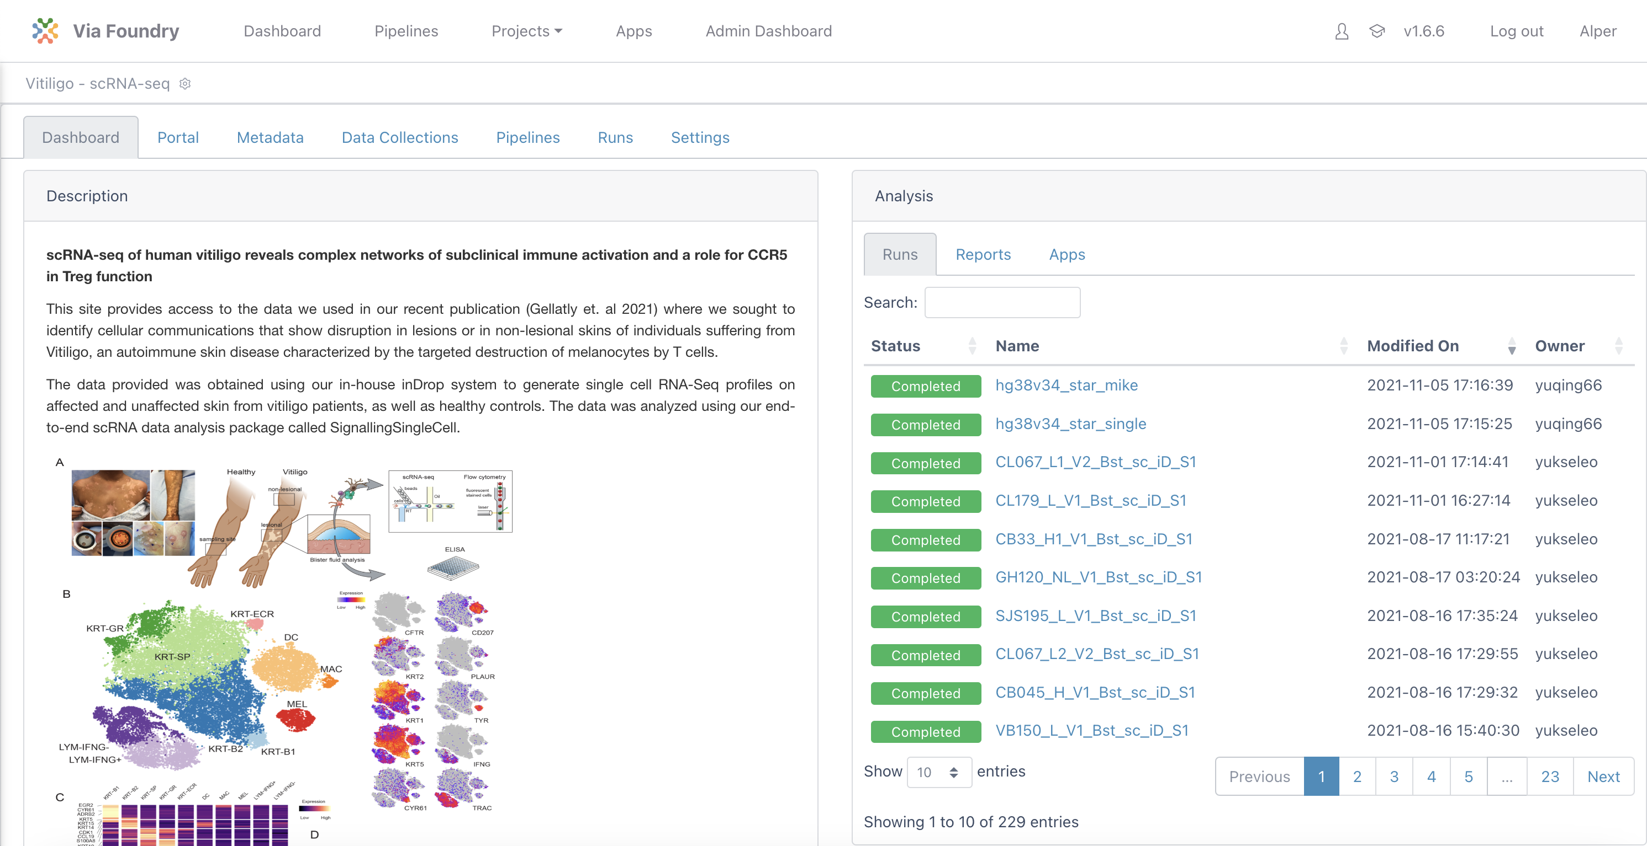
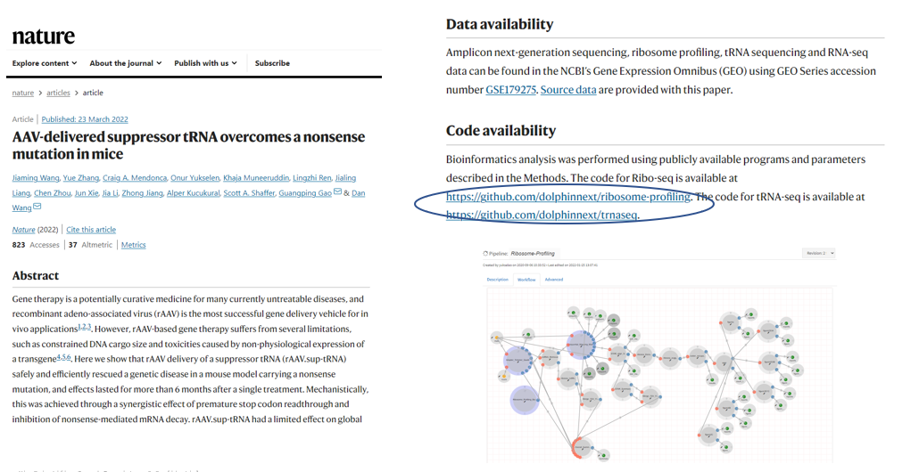
Via Foundry: Multi-omics Science
Holistic Operating System
Sharable and Reproducible
Via Scientific, Inc. | Proprietary & Confidential
Notes:
Acceleration – Shots on Goal
Reusability & reproducibility, versioning & institutional memory
Analytical freedom
Power aof the commons
Costs savings

Slide 11





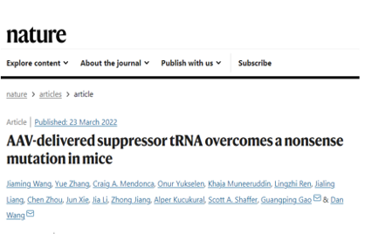
Via Foundry: Accelerating Data Analytics
Project Management / Collaboration
FAIR Data
Experiment Design
Reference
Data
Internal
Public
3rd Party
Other
Metadata
Pipelines
Import
Operationalize
Analyze
Epigenomics
Genomics
Transcriptomics
Proteomics
Metabolomics
Glycomics
Single cell
Lipidomics
Metagenomics
Other
Bio Samples Collected & Processed
Integrated
Customizable
Metadata server
Create pipelines
Select pipelines
Import pipelines
Illumina
PacBio
Nanopore
Data Processing
Full control
Versioning/provenance
Fusion
Insights
Refinement
Share - Publications
Augmented Intelligence
Generative / LLM / PE / Custom
Science Accelerated

Slide 12
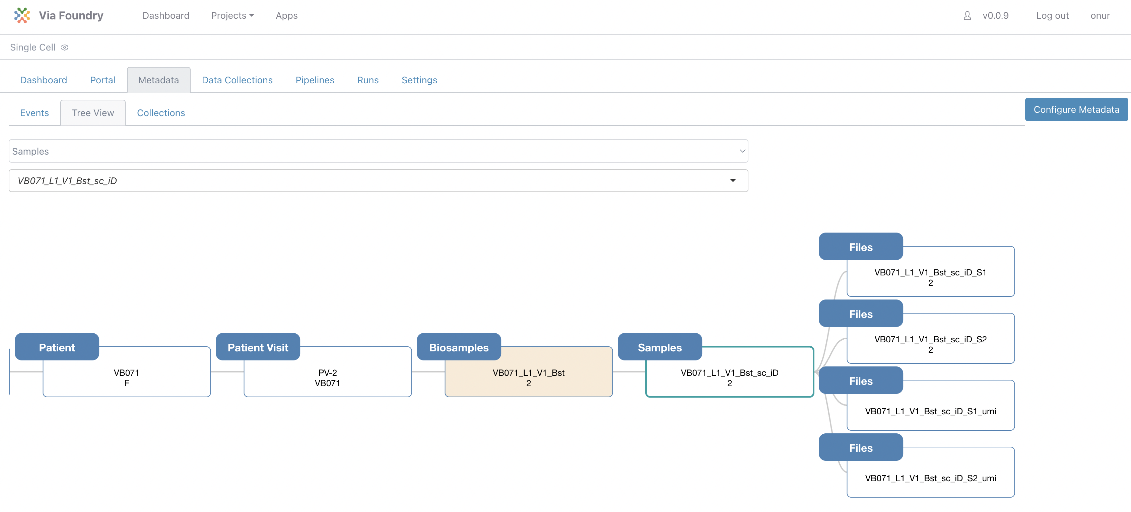
(1) Metadata Tracking
Sample Processing History
Hierarchical
Customizable – unlimited fields and parameters
Ontology server
Metadata/pipeline linkage
Automated metadata tagging
Via Scientific, Inc. | Proprietary & Confidential

Slide 13
Via Foundry: Accelerating Data Analytics
Project Management / Collaboration
FAIR Data
Experiment Design
Reference
Data
Internal
Public
3rd Party
Other
Metadata
Pipelines
Import
Operationalize
Analyze
Epigenomics
Genomics
Transcriptomics
Proteomics
Metabolomics
Glycomics
Single cell
Lipidomics
Metagenomics
Other
Bio Samples Collected & Processed
Integrated
Customizable
Metadata server
Create pipelines
Select pipelines
Import pipelines
Illumina
PacBio
Nanopore
Data Processing
Full control
Versioning/provenance
Fusion
Insights
Refinement
Share - Publications
Augmented Intelligence
Generative / LLM / PE / Custom
Science Accelerated

Slide 14
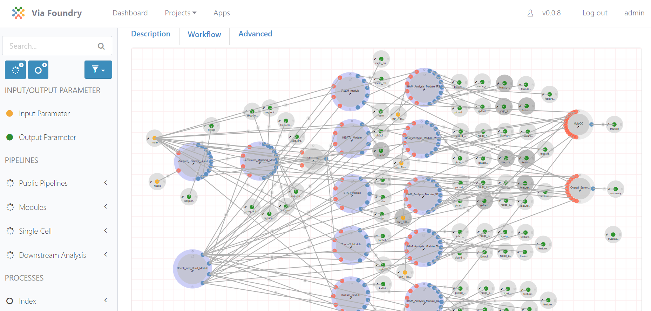
(2) Easy Data Processing Pipelines
Analytical Project Canvas
Pipeline creation & mgmt.
Drag & Drop pipeline design
Reusability & reproducibility
Versioning / integrations
Automated forms & parameters
Compute portability
Via Scientific, Inc. | Proprietary & Confidential

Slide 15
Illustrative Foundry Pipelines /Apps
Genomics
Transcriptomics
Epigenomics
3rd Party Apps
WGS
WES
Genome assembly
Genome annotation
GATK/Variant annotation
CRISPR
AAV analysis
Quantification
PacBio pipelines
Barcode sequencing
Bulk RNA-Seq
scRNA-Seq
Differential expression
CAGE-Seq
Transcriptome-wide editing
miRNA-Seq
tRNA-Seq
AAV analysis
Ribo-Seq
Quantification
ATAC-Seq
ChIP-Seq
Methyl-Seq
Super enhancers
Jupyter
R Studio
R Shiny apps
DEBrowser
iSEE
CellxGene
Clinical Knowledge Graph
GSEA / GO / KEGG / Disease analysis
AlphaFold
TensorFlow
Secondary Analyses
GSEA
Pathway enrichment
Cell deconvolution
Trajectory
+In addition NF Core & Third Party
Notes:
The platform has a large compendium of preexisting, validated, publicly available pipelines, developed over years at UMass and beyond - comprehensively covering genomics, epigenomics, and transcriptomics, available for use, reuse, and modification by Foundry subscribers. Nf-core pipelines are now available for use as well. We are working with Kraig Theriault’s lab for orchestration of scRNA-seq workflows, and we’re happy to speak with other parties to establish analysis capabilities.

Slide 16
Via Foundry: Accelerating Data Analytics
Project Management / Collaboration
FAIR Data
Experiment Design
Reference
Data
Internal
Public
3rd Party
Other
Metadata
Pipelines
Import
Operationalize
Analyze
Epigenomics
Genomics
Transcriptomics
Proteomics
Metabolomics
Glycomics
Single cell
Lipidomics
Metagenomics
Other
Bio Samples Collected & Processed
Integrated
Customizable
Metadata server
Create pipelines
Select pipelines
Import pipelines
Illumina
PacBio
Nanopore
Data Processing
Full control
Versioning/provenance
Fusion
Insights
Refinement
Share - Publications
Augmented Intelligence
Generative / LLM / PE / Custom
Science Accelerated

Slide 17
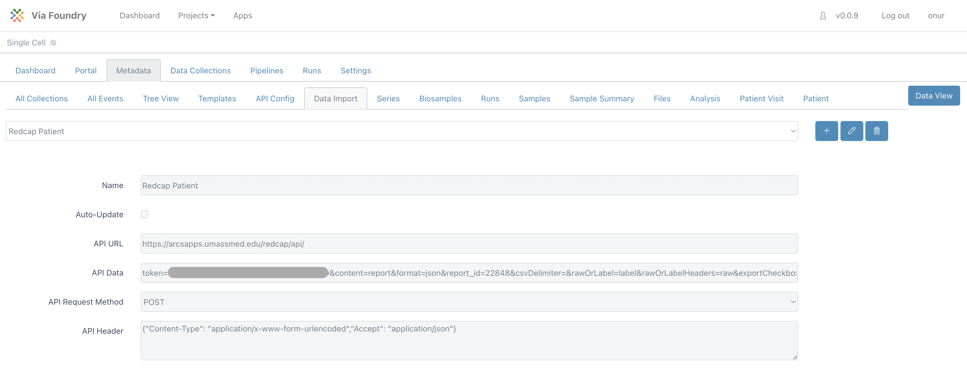
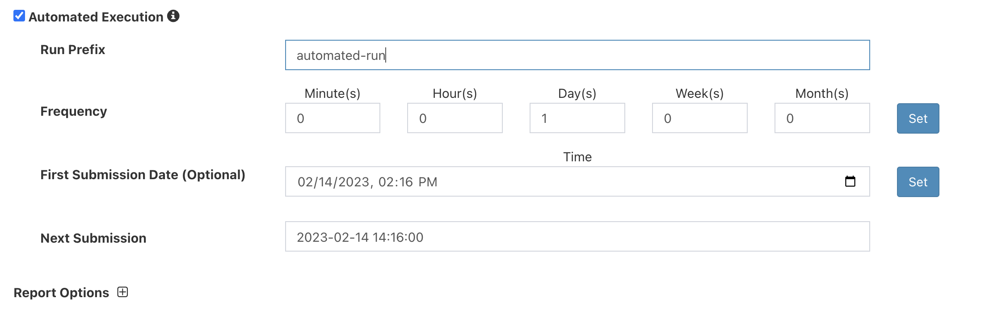
(3) Imports and Automates Data Ingestion
Automated Processing
Merge input files and metadata
Automated ingestion process
Readily incorporates 3rd party datasets
Easy access to reference genomes
Enables continuous analytics
Via Scientific, Inc. | Proprietary & Confidential

Slide 18
Via Foundry: Accelerating Data Analytics
Project Management / Collaboration
FAIR Data
Experiment Design
Reference
Data
Internal
Public
3rd Party
Other
Metadata
Pipelines
Import
Operationalize
Analyze
Epigenomics
Genomics
Transcriptomics
Proteomics
Metabolomics
Glycomics
Single cell
Lipidomics
Metagenomics
Other
Bio Samples Collected & Processed
Integrated
Customizable
Metadata server
Create pipelines
Select pipelines
Import pipelines
Illumina
PacBio
Nanopore
Data Processing
Full control
Versioning/provenance
Fusion
Insights
Refinement
Share - Publications
Augmented Intelligence
Generative / LLM / PE / Custom
Science Accelerated

Slide 19
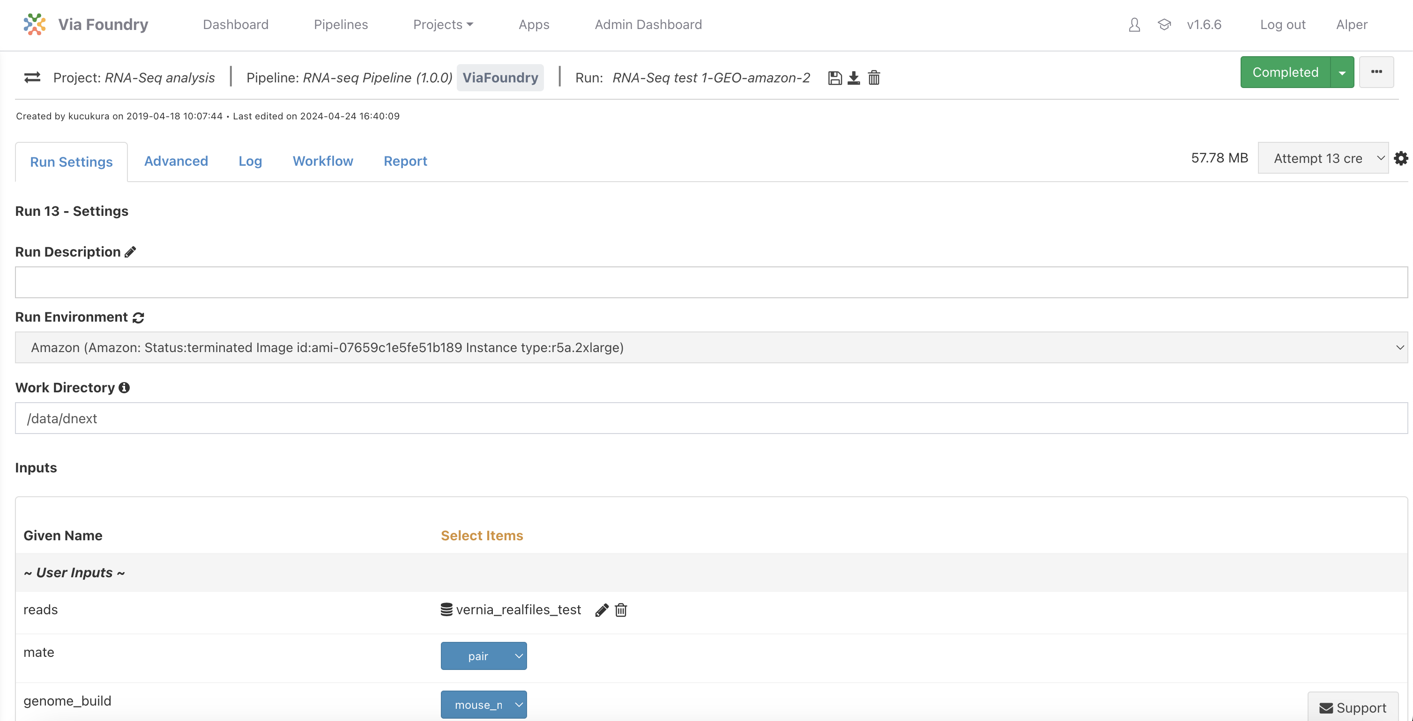
(4) Operationalize Your Pipeline: Execute Anywhere
Pipeline Execution
Can run pipelines on your cluster or in any cloud providers
Optimizes CPU/Memory
Backward compatibility
Tracks all your run attempts
Keeps parameters and run settings
Extensive versioning
Containerization
Via Scientific, Inc. | Proprietary & Confidential

Slide 20
Via Foundry: Accelerating Data Analytics
Project Management / Collaboration
FAIR Data
Experiment Design
Reference
Data
Internal
Public
3rd Party
Other
Metadata
Pipelines
Import
Operationalize
Analyze
Epigenomics
Genomics
Transcriptomics
Proteomics
Metabolomics
Glycomics
Single cell
Lipidomics
Metagenomics
Other
Bio Samples Collected & Processed
Integrated
Customizable
Metadata server
Create pipelines
Select pipelines
Import pipelines
Illumina
PacBio
Nanopore
Data Processing
Full control
Versioning/provenance
Fusion
Insights
Refinement
Share - Publications
Augmented Intelligence
Generative / LLM / PE / Custom
Science Accelerated

Slide 21
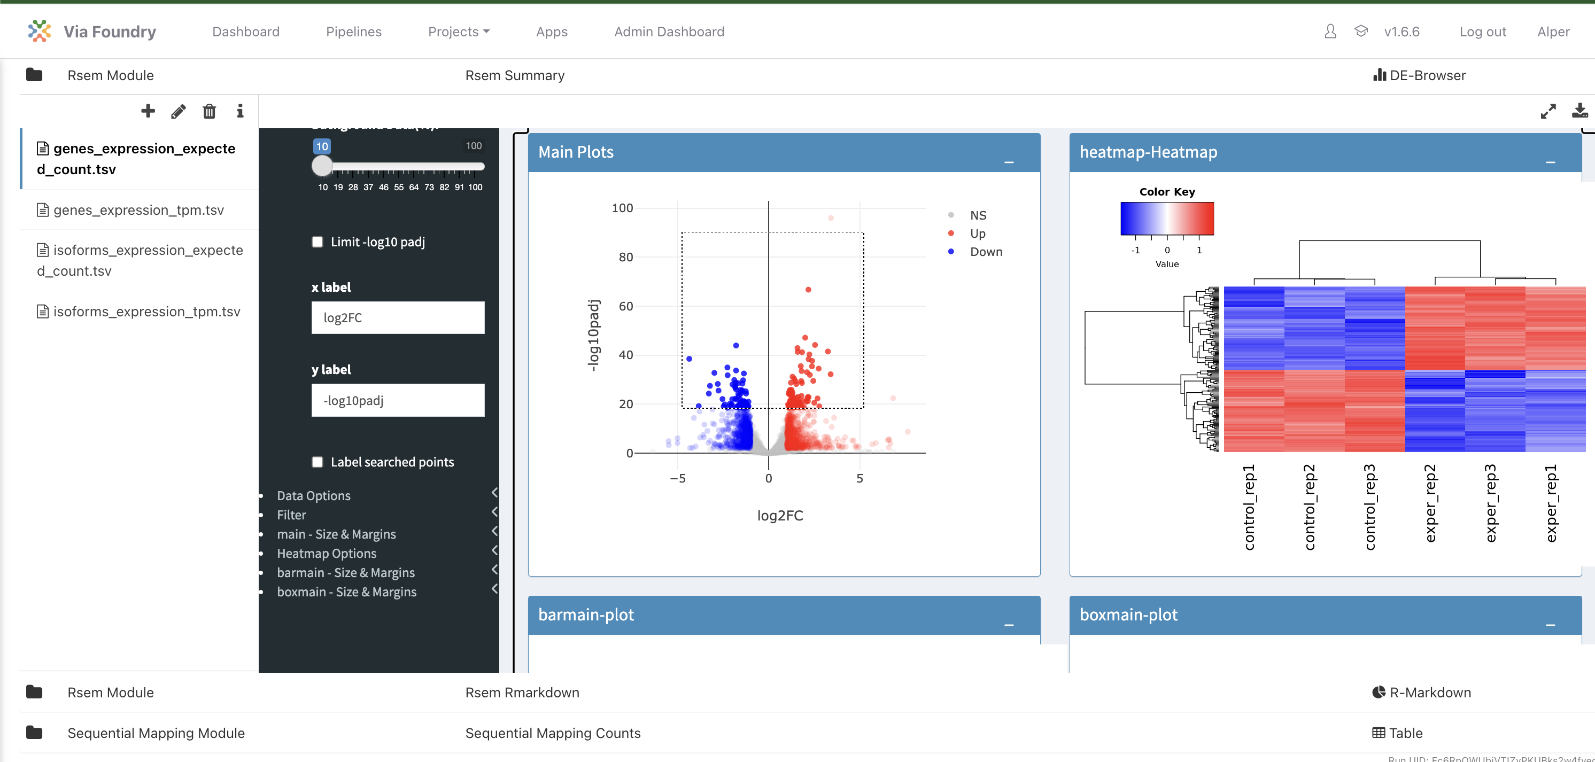
(5) Interrogation/Analytics
Accelerate Scientific Insight
Interactive data analytics
Embedded Jupyter Notebooks, R Studio, Shiny Apps etc.
Adding other 3rd party apps
Proprietary and public data
Accumulation & centralization of reports and data
Via Scientific, Inc. | Proprietary & Confidential

Slide 22
Via Foundry: Accelerating Data Analytics
Project Management / Collaboration
FAIR Data
Experiment Design
Reference
Data
Internal
Public
3rd Party
Other
Metadata
Pipelines
Import
Operationalize
Analyze
Epigenomics
Genomics
Transcriptomics
Proteomics
Metabolomics
Glycomics
Single cell
Lipidomics
Metagenomics
Other
Bio Samples Collected & Processed
Integrated
Customizable
Metadata server
Create pipelines
Select pipelines
Import pipelines
Illumina
PacBio
Nanopore
Data Processing
Full control
Versioning/provenance
Fusion
Insights
Refinement
Share - Publications
Augmented Intelligence
Generative / LLM / PE / Custom
Science Accelerated

Slide 23
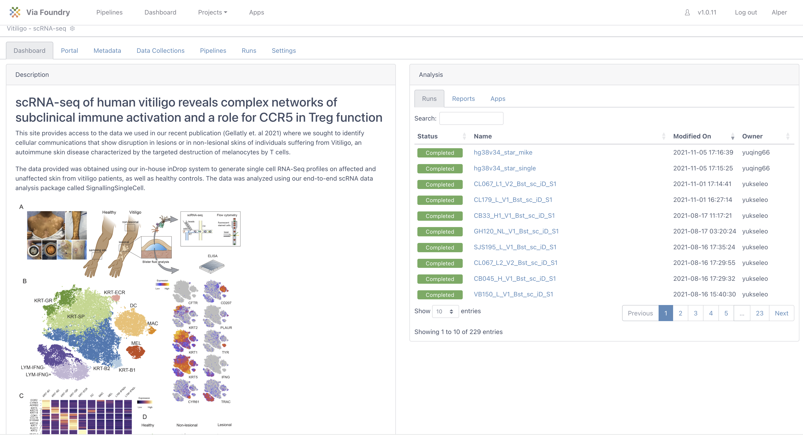
(6) Publishing
Accelerate Scientific Insight
Sharing
Community
Knowledge Acceleration
Proprietary and public
Partners / Collaborators
Share all pipelines and project results in your publications
23
Via Scientific, Inc. | Proprietary & Confidential

Slide 24





Foundry Key Values
Manage
Ingest
Analyze
Visualize
Process Mgmt.
Import Data
Execute Pipelines
Native Apps
Custom Portals
Notebooks
Workflow Tracking
Reference Data
Samples / Bio-Samples
Instrument Data
No Code Creation
Select or Import
3’rd Party (e.g.nf-core)
Data Repositories
Differential expression etc.
Custom visualizations.
Org. Mgmt.
Metadata
Access Pipelines
3rd Party Apps
Project/User Mgmt.
Sharing and Reporting
Collaboration
Integrated
Customizable
Ontology Server
Public Pipeline Repository
User Improvements
Power of the Commons
R Shiny / Jupyter / CKG etc.
CellxGene / iSEE etc.
LLM / Prompt Analytics
Central Control
Automation
(Re)use/Modify
Interactive Views
Inst. Knowledge
Optimization
Versioning/Audit
Share Results
Science Accelerated

Slide 25
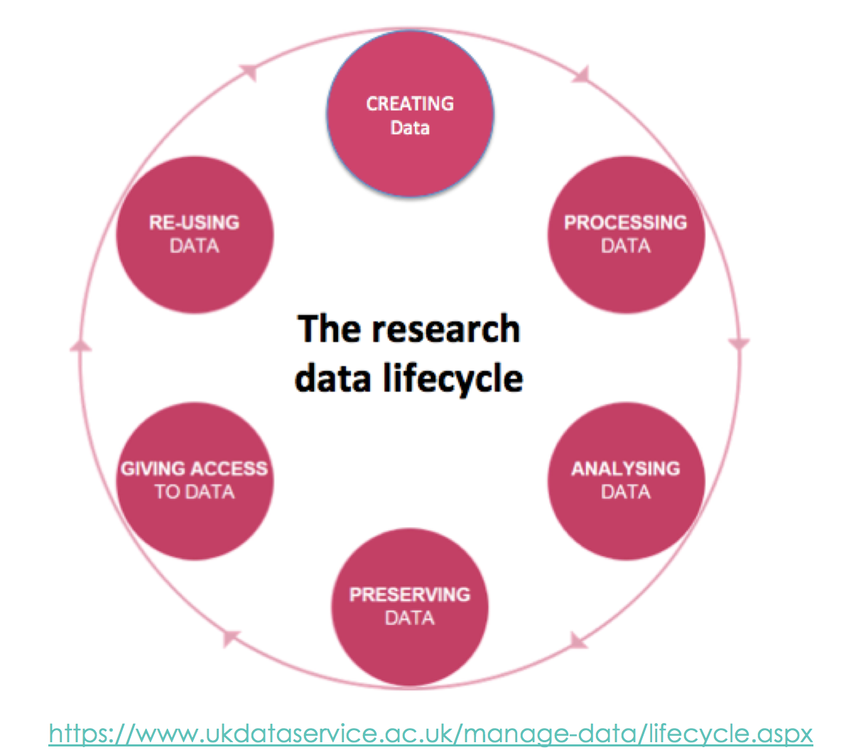
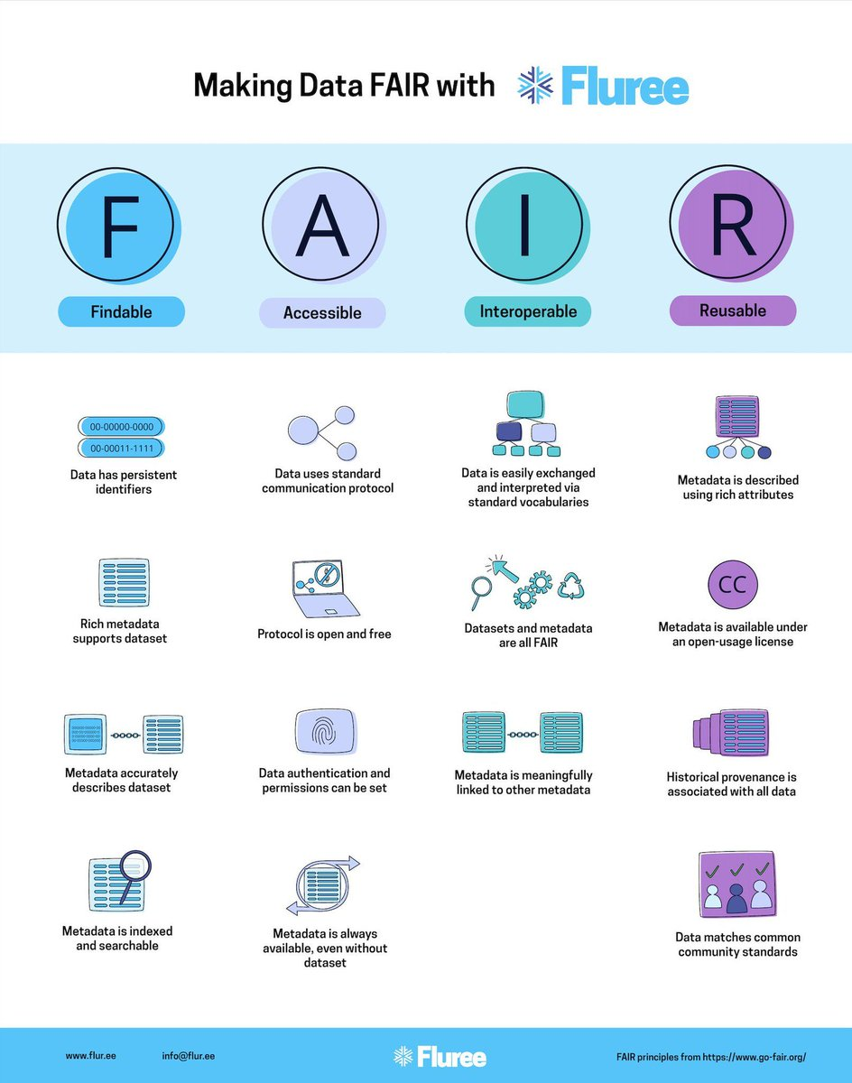
Best Practices for Reproducible Data Processing
Avoid manual data manipulation steps
Archive the exact versions of all external programs used
Version control all custom scripts
Provide (public) access to scripts/pipelines, runs, and results in FAIR standards
FAIR standards:
Searchable metadata
accurately describes
dataset
- Standard APIs
- Authentication
- Permission control
Integration with Ontology servers
Data and metadata are well described to be reused
Kulkarni et. al, Oct 2019, BMC Bioinformatics

Slide 26
Via Scientific
We Know The Pain
Without Via Foundry
3
1
x
With Via Foundry
65+
3
x/20
Bioinformaticians
Simultaneous teams and projects supported
Time-per-project
Core IP developed for over a decade out of necessity at UMass Chan Medical.
Via Foundry was created to massively accelerate scientific productivity.

Slide 27

Summary
Accelerated Research
TIME TO INSIGHT
Ask more questions of your data.
Shorten timelines.
Future Proof
NO LIMITS
Unlimited pipelining / analytics.
“Future proof” - anticipates changing science and algorithms.
Knowledge Accumulation
INSTITUTIONAL & GLOBAL MEMORY
Shareability, reproducibility.
Accumulation of all methods, means, and processes.

Slide 28
Thank You
Alper Kucukural
alper@viascientific.com
www.viascientific.com

